Slide 1

Improving Authenticated Dynamic Dictionaries, with
Applications to Cryptocurrencies
By\Hadeel Alghannam

Slide 2

Outline
V i r g i n i a C o m m o n w e a l t h U n I v e r s i t y
  Motivation
  The problem
  Observation
  Implementation results
  Conclusion

Slide 3

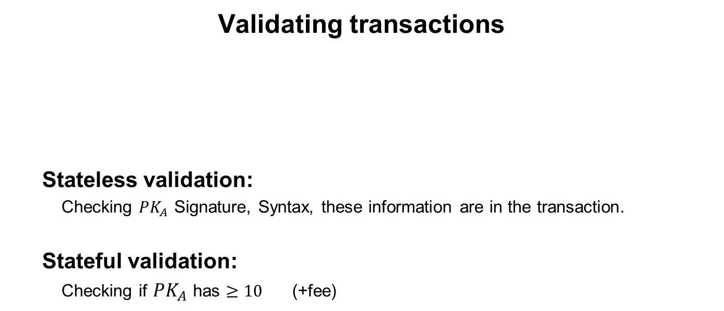
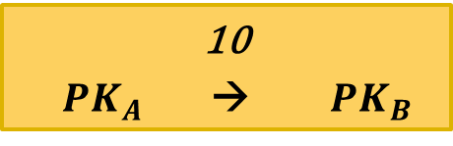
Motivation
V i r g i n i a C o m m o n w e a l t h U n I v e r s i t y
  Validating transactions
    Stateless validation:
    Checking $PK_{A}$ Signature, Syntax, these information are in the transaction.
    Stateful validation:
Checking if $PK_{A}$ has $≥10$ (+fee)
  10
  $PK_{A}$ → $PK_{B}$

Slide 4
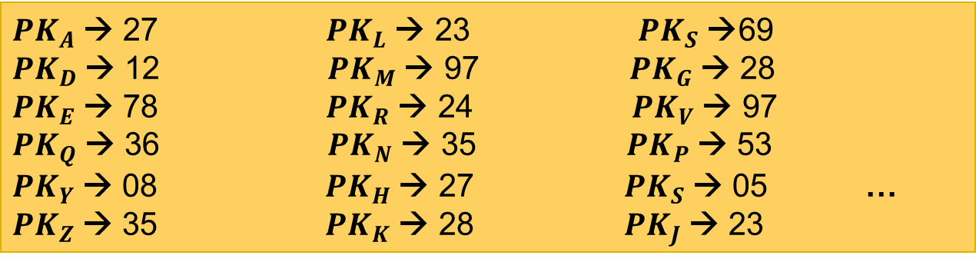
Motivation
V i r g i n i a C o m m o n w e a l t h U n I v e r s i t y
$PK_{A}$→ 27 $PK_{L}$→ 23 $PK_{S}$→69
$PK_{D}$→ 12 $PK_{M}$→ 97 $PK_{G}$→ 28
$PK_{E}$→ 78 $PK_{R}$→ 24 $PK_{V}$→ 97
$PK_{Q}$→ 36 $PK_{N}$→ 35 $PK_{P}$→ 53
$PK_{Y}$→ 08 $PK_{H}$→ 27 $PK_{S}$→ 05 …
$PK_{Z}$→ 35 $PK_{K}$→ 28 $PK_{J}$→ 23

Slide 5
The problem
V i r g i n i a C o m m o n w e a l t h U n I v e r s i t y
Blockchain validation requires storing a large state
1
Disk storage :
Slow validation
2
  RAM :
  Bought a lot of RAM → limiting the ability for weak devices to validate.

Slide 6
Observation
V i r g i n i a C o m m o n w e a l t h U n I v e r s i t y
Transaction verifier does not need this data structure.
$PK_{A}$→ 27 $PK_{L}$→ 23 $PK_{S}$→69
$PK_{D}$→ 12 $PK_{M}$→ 97 $PK_{G}$→ 28
$PK_{E}$→ 78 $PK_{R}$→ 24 $PK_{V}$→ 97
$PK_{Q}$→ 36 $PK_{N}$→ 35 $PK_{P}$→ 53
$PK_{Y}$→ 08 $PK_{H}$→ 27 $PK_{S}$→ 05 …
$PK_{Z}$→ 35 $PK_{K}$→ 28 $PK_{J}$→ 23
Proof of fact that Alice has > 10
Use authenticated data structures and Alice will prove as part of the transaction that she has enough money, we’ll authenticate this key value store, show Alice has 27 B.

Slide 7

Authenticated Account Balance
V i r g i n i a C o m m o n w e a l t h U n I v e r s i t y
Block header
Assent Data
Transection root hash
..
..
Account root hash
Account root hash
hash hash
hash hash hash hash
$PK_{A}$ 27 $PK_{B}$ 78 $PK_{C}$ 24 $PK_{D}$12 $PK_{E}$ 78 $PK_{F}$23 $PK_{G}$ 28 $PK_{H}$ 478

Slide 8
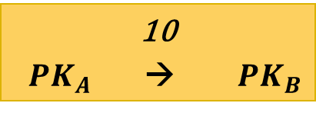
Authenticated Account Balance
V i r g i n i a C o m m o n w e a l t h U n I v e r s i t y
Block header
Assent Data
Transection root hash
..
..
Account root hash
Account root hash
hash hash
hash hash hash hash
$PK_{A}$ 27 $PK_{B}$ 78 $PK_{C}$ 24 $PK_{D}$12 $PK_{E}$ 78 $PK_{F}$23 $PK_{G}$ 28 $PK_{H}$ 478
  10
  $PK_{A}$ → $PK_{B}$

Slide 9
Authenticated Account Balance
V i r g i n i a C o m m o n w e a l t h U n I v e r s i t y
Block header
Assent Data
Transection root hash
....
Account root hash
Transactions + Proofs Yes/No
Verifier

Slide 10


Minor (Prover)
V i r g i n i a C o m m o n w e a l t h U n I v e r s i t y
Block header Next block header
Assent Data
Transection root hash
..
..
Account root hash
……
New root hash
Account root hash
hash hash
hash hash hash hash
$PK_{A}$ 2717 $PK_{B}$ 78 88$PK_{C}$ 24 $PK_{D}$12 $PK_{E}$ 78 $PK_{F}$23 $PK_{G}$ 28 $PK_{H}$ 478

Slide 11
Verifier
V i r g i n i a C o m m o n w e a l t h U n I v e r s i t y
Block header Next block header
Assent Data
Transection root hash
....
Account root hash
……
New root hash
=
Transactions + Proofs Yes/No + new root hash
Verifier needs to check the new root hash.
Verifier

Slide 12
V i r g i n i a C o m m o n w e a l t h U n I v e r s i t y
Need to support Authentication and root hash update for :
Update key value.
Insert new(key, value) .
Delete key .

Slide 13
Two-party model
V i r g i n i a C o m m o n w e a l t h U n I v e r s i t y
Block header Next block header
Assent Data
Transection root hash
....
Account root hash
……
New root hash
=
Transactions + Proofs Yes/No + new root hash
Verifier
This can be trusted because verified from previous block ,
all the way back from the genesis.

Slide 14
Proof Length
V i r g i n i a C o m m o n w e a l t h U n I v e r s i t y
All previous works are based on Merkle Trees.
 | Previous works |  | The paper work
 | Skip list | Red-Black+ | AVL +
Update existing | 1.5 H log N | (H+K) log N | H log N
Insert new | 1.5 H log N | 3 (H+K) log N | H log N
 | Required trusted randomness | Required using more nodes | Optimal
N = number of public keys
H= length of Hash
K= length of PK

Slide 15
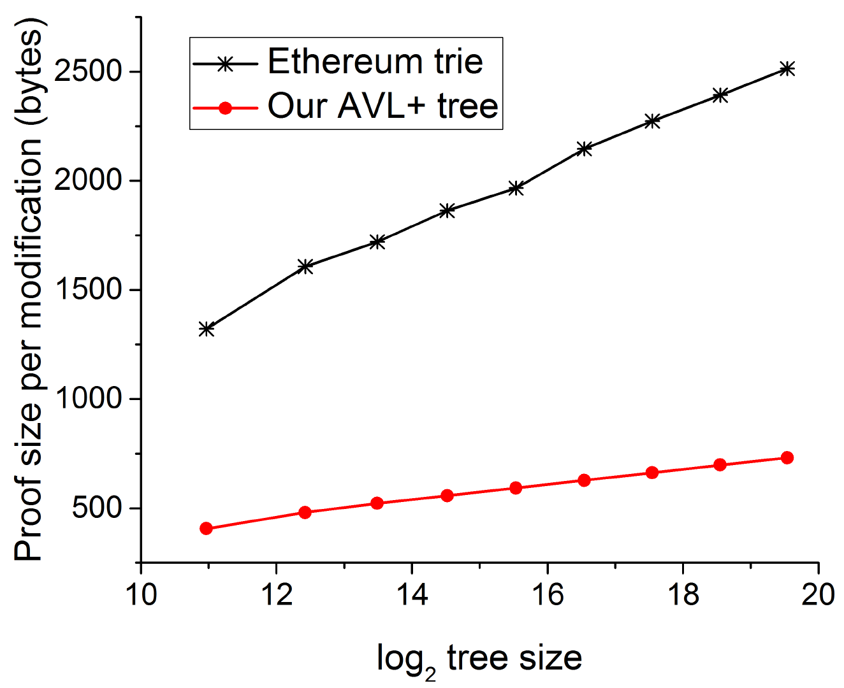
Implementation results
V i r g i n i a C o m m o n w e a l t h U n I v e r s i t y
Single-op proof size

Slide 16
Implementation results
V i r g i n i a C o m m o n w e a l t h U n I v e r s i t y
Single-op proof size
For N=1 000 000 keys
Proof size= 765bits at high security value 128 bit security.

Slide 17
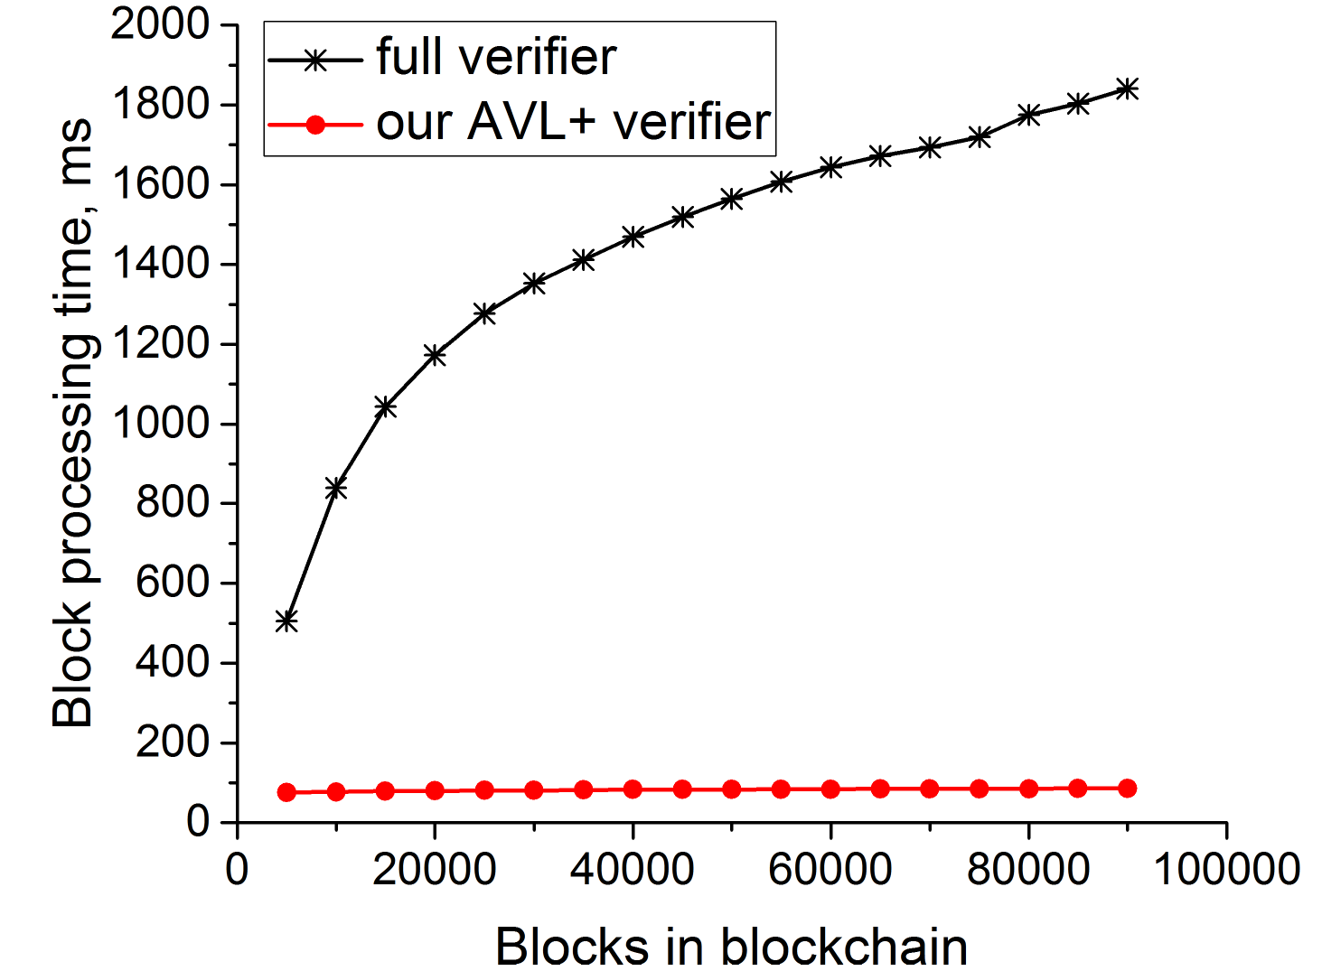
Conclusion
V i r g i n i a C o m m o n w e a l t h U n I v e r s i t y
Authenticated data structures enable verification on commodity hardware.

