Slide 1
Non outsourceable Scratch Off Puzzle to Discourage Bitcoin Mining Coalitions Authors: Andrew Miller, Ahmed Kosba, Jonathan Katz, Elaine Shi
Presented by: Ramandeep Kaur Sandhu

Slide 2
Bitcoin
A decentralized currency
No single entity holds the large fraction of computational resources in the network.
Violation of the above assumption can lead to several attacks.

Slide 3
The Problem
Mining coalition has lead to the concentration of mining power.
Mining pools and hosted mining – mining coalition.
Mining pools- it restricts the mining risk and obtain the mining rewards at the stable rate
Eg- Ghash I.O
Hosted Mining- individuals outsource their mining effort to one or few service providers.
Threat to the security of the bitcoin or bitcoin like currencies.

Slide 4
The Objective( Intuition )
Propose a puzzle which
can disable such outsourcing mechanisms and deter the mining coalition.
is non outsourceable and retain the decentralized nature of bitcoin mining

Slide 5
How do the mining pool operates
members – submit the cryptographic proofs (called shares) to other pool members ( or the pool operator).
Work – tied with the public key of the pool operator.

Slide 6
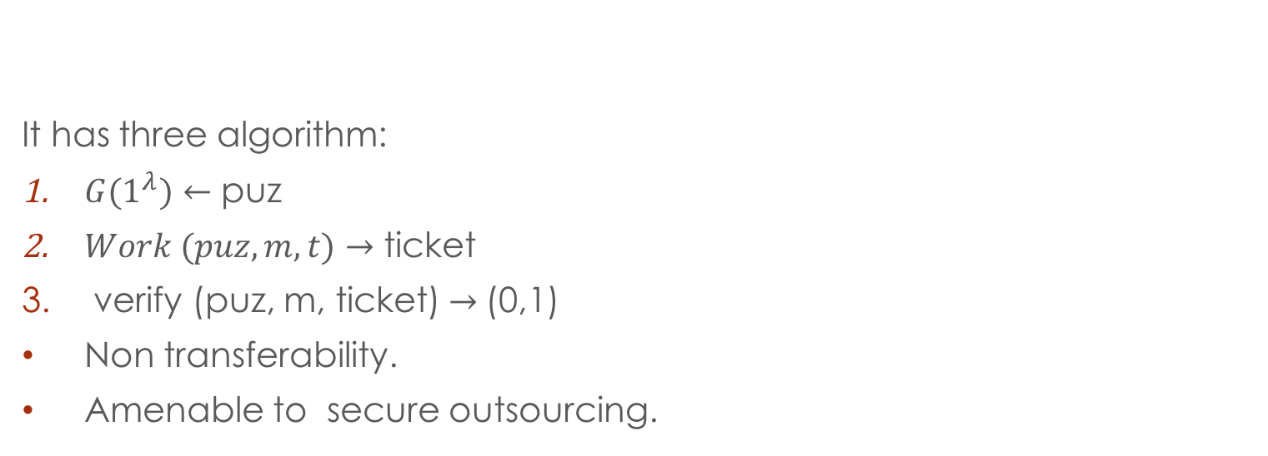
Scratch Off Puzzle
It has three algorithm:
$G(1^{λ})←$ puz
$Work (puz, m,t)→$ ticket
verify (puz, m, ticket)$→$(0,1)
Non transferability.
Amenable to secure outsourcing.

Slide 7
Non Outsourceable Puzzle
Weak non outsourceable puzzle
Strong non outsourceable puzzle
No effective outsourcing protocol exists.
Assumptions:
Pool operator executes the protocol correctly and the worker may deviate arbitrarily.
$t_{c}$ be the work performed by the pool operator.
$t_{s}$ be the work performed by the worker.
$t_{e}$ be the effective amount of the work during the protocol.
Payload m is computed during the interaction between the pool operator and the worker.
Effective outsourcing can only exist, if $t_{e}$ is greater than $t_{c}$ .

Slide 8
Weak Non Outsourceable Puzzle
There always exists an adversary which can steal the pool operator’s winning ticket.
The effectiveness depends upon how much effective work $t_{e}$is performed by pool operator.
Worker must possess the large part of the signing key, if he is doing the large part of the mining computation.
The adversary will run the honest protocol , until it finds the ticket for payload m and transforms the ticket into m* .
During the execution, if the pool operator outputs a valid ticket m and the adversary (worker) produces a ticket m* for the same puz instance, then there is a race between the which ticket is accepted by the network .

Slide 9
Weak Non Outsourceable Puzzle Cont’d
If the adversary can modify the ticket for the different payload m* , then the adversary can listen for when the victim ticket gets announced in the network.
If the worker( adversary) has the better network connectivity, then the adversary can outrace the victim.
Main drawback – the adversary can be detected.

Slide 10
Strongly non outsourceable puzzle
Weakly non outsourceable puzzle can be detectable, if the adversary spends the stolen award.
The strongly non outsourceable puzzle enables the worker(adversary) to spend the stolen award without being detected.

Slide 11
Strongly Non outsourceable Puzzle Cont’d
The stolen ticket cannot be distinguishable from the ticket produced through independent effort.
In bitcoin , the message payload m contains the public key to which the reward is assigned.
The stealing worker should bind its substituted payload m* to the freshly generated public key for which it know the corresponding private key.

Slide 12
Integrating the Puzzle with Bitcoin like Currencies
In the proposed puzzle, GenPuz($1^{λ})$ must be random function ,that generates the puzzle instance and this function returns the random string.
In bitcoin, each puzzle is generated by the applying the hash function to the solution of the previous puzzle.
In the proposed puzzle , each next puzzle instance is generated from the hash of the previous solution and message
puz’$≡H(puz∥m∥ticket)$

Slide 13
Conclusion
The puzzle achieves the two guarantees:
If the worker is doing the large part of the mining computation, then it must possess a sufficiently large part of the signing key such that it can later sign over the reward to its own public key, effectively stealing the reward from the pool operator.
The adversary can spend the stolen reward in a way that reveals no information about the adversary.
If we can enforce the above, then any pool wishing to outsource its work to an untrusted party runs the risk of losing its entitled mining reward, thus creating the disincentive to outsource mining work.

Slide 14
Thankyou

