Slide 1
The Ring of Gyges: Investigating the Future of Criminal Smart Contracts
Mooriah Rowser

Slide 2
Agenda
Smart Contract vs. Criminal Smart Contract
CSC Challenges
Three Types of Crimes
Countermeasures
Summary

Slide 3
Smart Contract vs. Criminal Smart Contract
Smart Contract: a generic term denoting programs written in Turing-complete cryptocurrency scripting languages
Criminal smart contracts(CSC): can facilitate leakage of confidential information, theft of cryptographic keys, and various real world crimes(murder, arson, terrorism)

Slide 4
CSC Challenges
Commission- Fair
Limited opcodes

Slide 5
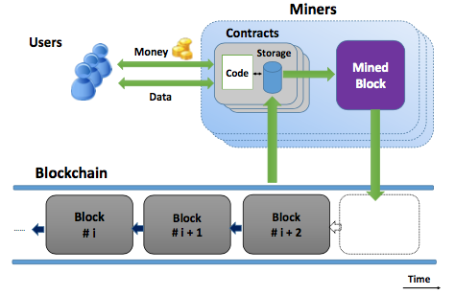

Slide 6
Three Types of Crime
Leakage / Sale of secret documents
Theft of private keys
“Calling Card” crimes (physical crimes)

Slide 7
Leakage / Sale of Secret Documents
Darkleaks
Vulnerabilities
Generic Public Leakage CSC

Slide 8
Theft of Private keys
Key Theft
Key Theft Naive
Flaws and Solutions
Target and state exposure
zk-SNARK

Slide 9
“Calling Card” Crimes
Calling Card: is an unpredictable feature of a to-be-executed crime
Calling cards alongside authenticated data feeds, can support a general framework for a wide variety of CSCs.

Slide 10
Countermeasures
Blacklisting
Trustee-tracing
Trustee-neutralizable smart contracts

Slide 11
Summary
Talked about the difference between smart contracts and criminal smart contracts
Challenges faced in CSC
Three types of crime associated with CSC; leakage of secret information, theft of private keys, and calling card crimes

Slide 12
Thank You!

