Slide 1
Zerocash: Decentralized Anonymized Payments from Bitcoins
Andrew Morris

Slide 2
Zerocash
The concept was developed by: Eli Ben-Sason, Alessandro Chieso, Christina Garman, Matthew Green, Ian Miers, Eran Tromer, and Madars Virza
Zerocash was presented at the 2014 IEEE Symposium on Security and Privacy.
You may remember our guest lecturer, Matthew, whose startup is attempting to capitalize on mining ZCash.

Slide 3
Brief History of Digital Monies
1980s- Digital Cash in the Netherlands
Late 80’s- Chaum’s Digicash- blinded transactions, but legally bound to central banks
E-gold- Backed by central authority, victim of post 9/11
Bitcoin

Slide 4
Zerocoin
Developed by many of the same authors as this paper
Logical predecessor to Zerocash
Introduced zk-Snarks to verify the validity of coins
Made steps towards achieving total anonymity and privacy, but was ultimately impractical
Transactions were cumbersome
TX’s needed to be atomic
No way to send Zerocoin to users

Slide 5
zk-SNark
Zero-Knowledge Succinct Non-Interactive Arguments of Knowledge
Essentially, this allows any user, public or private to verify the correctness of a computation without actually performing the computation, or knowing what computation was executed.
Used in both Zerocoin and Zerocash to authenticate coins

Slide 6
Goals
Part of the goals of the Zerocash team was to build a practical anonymous and private currency, essentially elevating Zerocoin to the next level

Slide 7
Zerocash vs. ZCash
Zerocash is the underlying cryptographic protocol that makes ZCash possible, while ZCash is built primarily on the back of Zerocash, ZCash has added some marginal differences.
It is worthwhile to note that all of the aforementioned authors of the Zerocash paper are developers on the ZCash team. (ZCash)

Slide 8
Understanding the Issue with BTC
Not Anonymous!
Easily traceable using blockchain analysis of the public ledger
Legitimate users have a concern for privacy
“But there are tumblers” !?!?

Slide 9
Tumblers/Mixers
How Tumblers/Mixers work
Issues that can/have arisen from Tumblers
Is this really a solution?

Slide 10
Zerocash
Zerocash aims to be a solution to the issue of the lack of anonymity in BTC.
In doing so, Zerocash aims to achieve two primary goals:
Allow for anonymous TX of variable amounts
And hide TX amounts and the values of coins held by users.
In Zerocash, this is accomplished by using a Decentralized Anonymous Payment system.

Slide 11
Backbone of Zerocash
Zerocash is conceptually backed by the Decentralized Anonymized Payment Scheme
What is DAP?
Sits atop the Bitcoin ledger
6 Concrete Steps

Slide 12
Step 1: User anonymity with fixed value coins
Conceptually developed with fixed value coins (atomic BTC only)
Process of theoretically minting a coin by depositing to a backed escrow account. -----> Left with coin “c”
How do you spend “c”?
“C” is validated by a combination of serial number and zk-SNARK proof to establish “c” exists in the mint
zk-SNARK= zero knowledge Succint non-interactive ARguments of Knowledge?

Slide 13
Step 2: Compressing the list of Coin Committments
The “mint” in step 1 is linear- list like
By using collision resistant hash function, CRH, we can change the way time and space is compiled. From linear ----> logarithmic
With a merkle tree (mint) depth of 64, there are 2^64 coins available
A total of 1.8446744e+19 coins

Slide 14
Step 3: Extending coins for Direct Anonymous Payments
Up to now, our model is theoretically sound and anonymous, but highly impractical.
To remedy this we add addresses (targets for payments) and the ability to derive non atomic coins
Coins are spent using the “pour” operation

Slide 15
Step 4: Sending Coins
Makes use of a key pair for private key encryption by adding public keys and secret keys to the addresses. (addr-pk,addr-sk)
Example send TX:
1: User1 wishes to send coins to User 2, begins by encrypting cypher text © using User2’s pk
2: User1 includes © in the POUR TX, User 2 can scan the ledger and then decrypt © with their SK

Slide 16
Step 5: Public Outputs
How do we go from Zerocash to Bitcoin?
Modify the POUR transaction to include a public output
The string info. Included helps to determine the destination of the funds

Slide 17
Step 6: Non-Malleability
How do we prevent the double spend problem and other malicious users?
We add a digital signature scheme to the POUR TX
Utilizes Collision Resistant Hashing and a high-entropy system, wherein the signed values change frequently

Slide 18
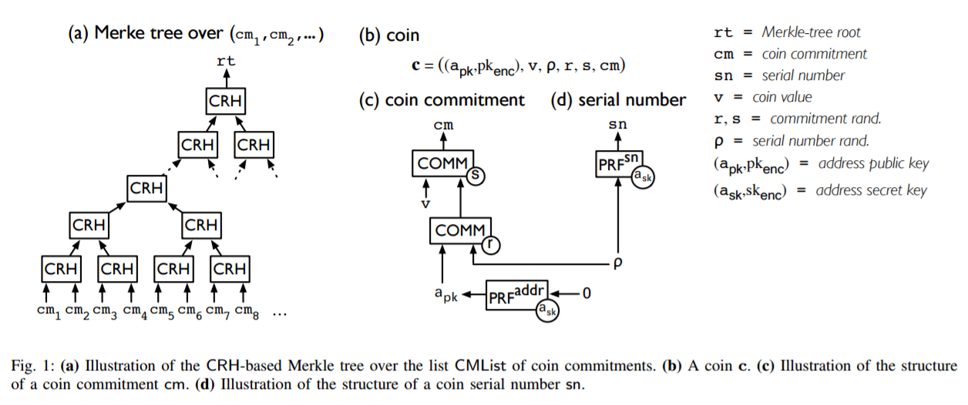
CRH based Merkle Tree

Slide 19
Are we Secure?
Must satisfy three requirements- ledger indistinguishability, transaction non-malleability, and balance

Slide 20
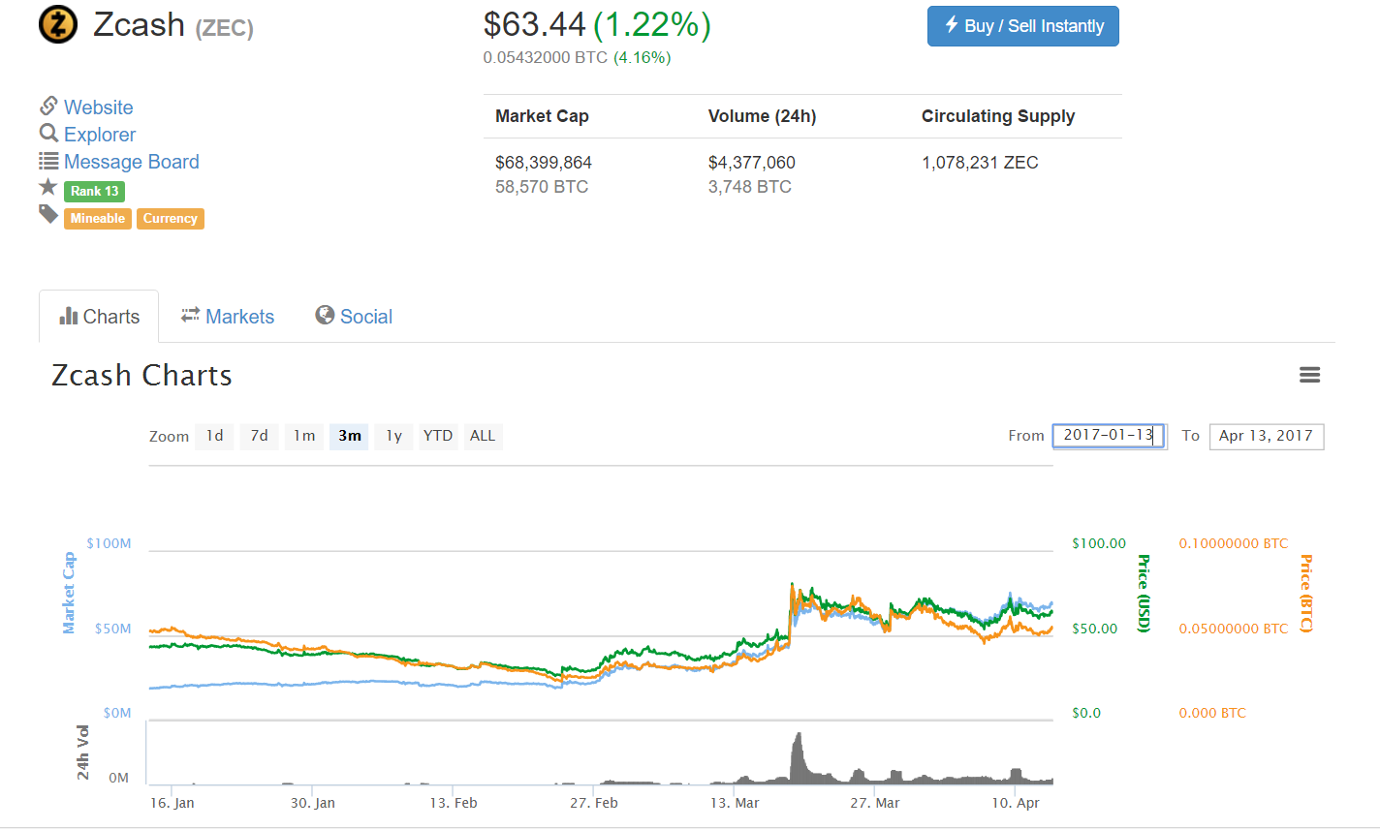
Implementation?

